Slide 1
Graph Data Mining
Marko Cvijetinović 7/2022

Slide 2
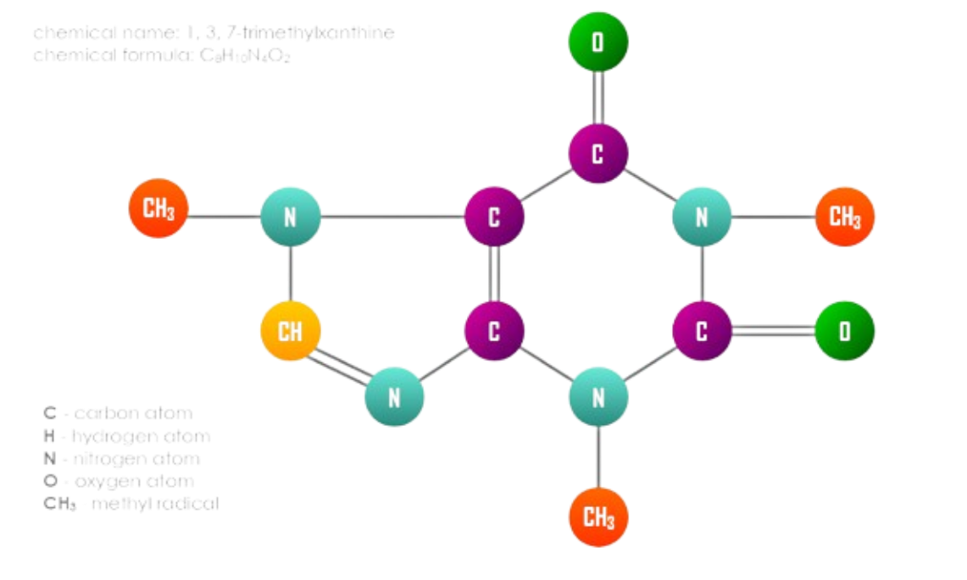
Introduction
We consider a base of smaller graphs, where the entire graph is the unit of classification or clustering, and the nodes carry labels. This is a common situation in biology and chemistry
Optionally the branches have values ​​(covalency of a bond in chemistry for example)
Graphs are a very general data structure
But the problems are usually NP hard, especially because of repeating labels

Slide 3
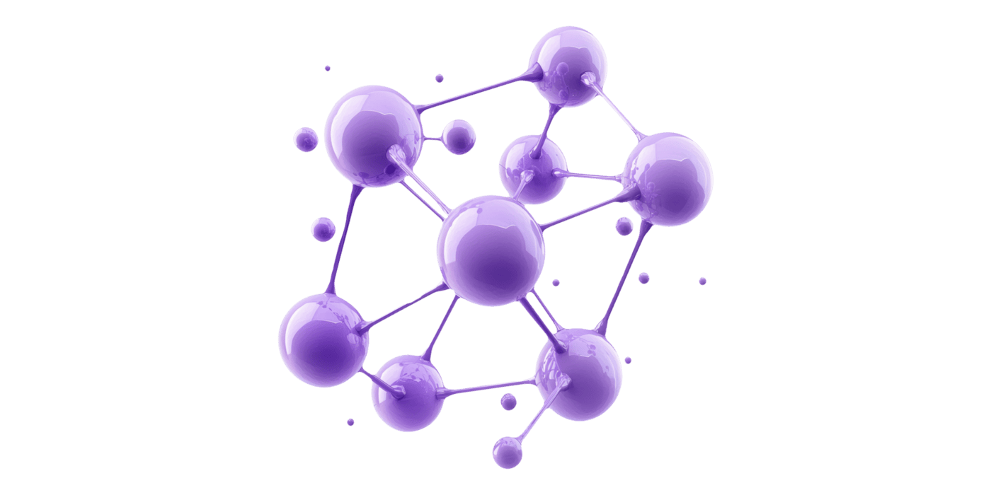
Introduction
Goal: We want to apply some of the classic machine learning algorithms
Possible approaches
Graph distance calculation -> distance based algorithms
Through maximum common subgraph
Through edit distance
Transforming graphs into a series of features -> any algorithm that works on a data frame
Computation of topological graph descriptors
Frequent subgraph mining

Slide 4
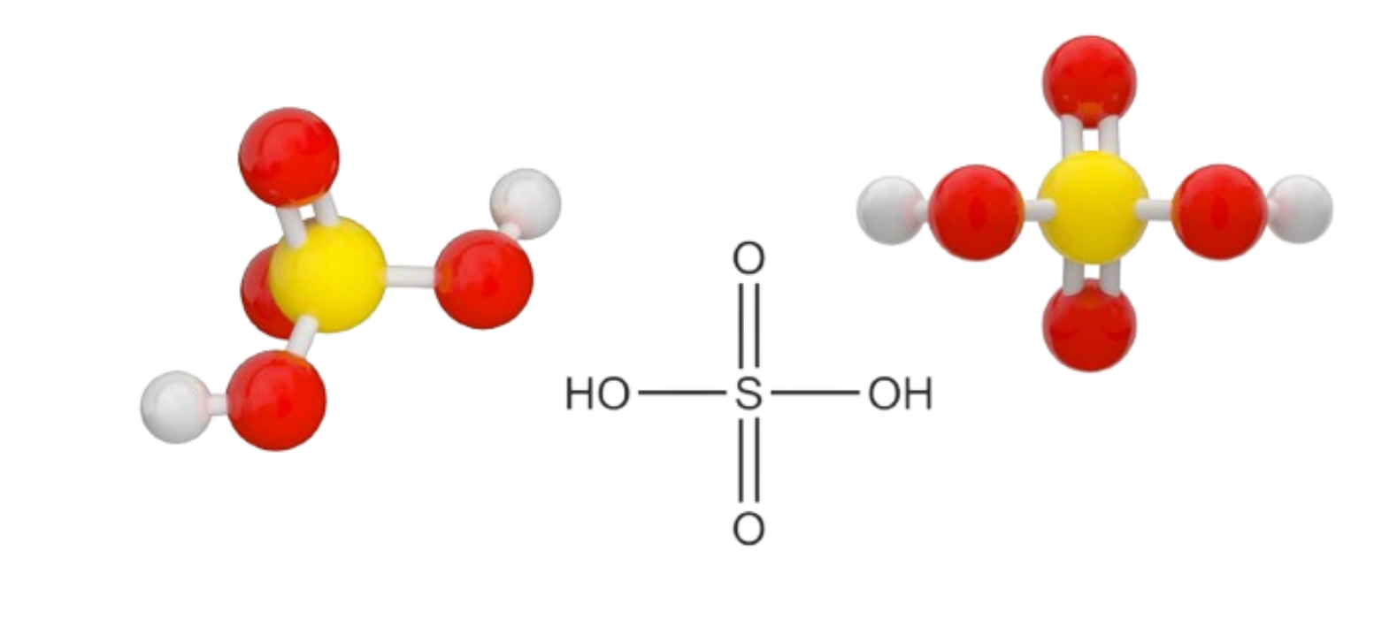
Graph isomorphism
We say that two graphs are isomorphic if we can map the nodes of one to the nodes of the other, so that all edges are preserved and we map the node exclusively to one with the same label
We say that one graph is a subgraph isomorphism of another if it is isomorphic to some of its subgraphs
The largest common subgraph of two graphs is their common subgraph isomorphism with the largest possible number of nodes

Slide 5
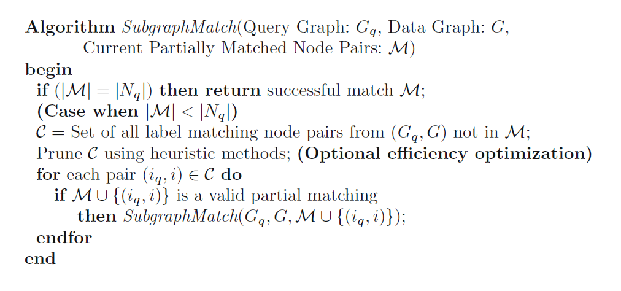
Graph isomorphism
Ullmann's algorithm for subgraph isomorphism:
Connecting all pairs of nodes with the same labels
Adding matching pairs to the current graph until we build the entire smaller graph
Improvement through heuristics
There is a variant for the greatest common subgraph

Slide 6
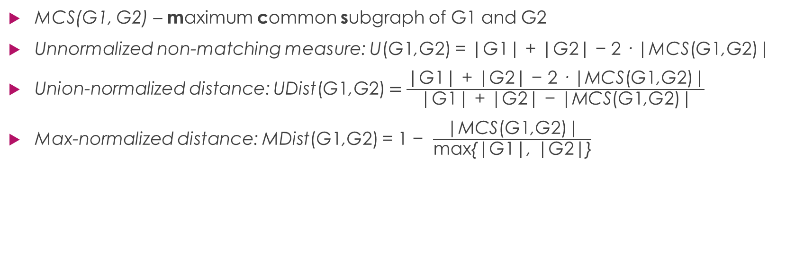
Graph isomorphism
MCS(G1, G2) – maximum common subgraph of G1 and G2
Unnormalized non-matching measure: U(G1,G2) = |G1| + |G2| − 2 · |MCS(G1,G2)|
Union-normalized distance: UDist(G1,G2) $=\frac{\text{|}\text{G}\text{1}\text{| }\text{+ }\text{|}\text{G}\text{2}\text{| − }\text{2 }\text{· |}\text{MCS}\text{(}\text{G}\text{1}\text{,}\text{G}\text{2)}\text{|}}{\text{|}\text{G}\text{1}\text{| }\text{+ }\text{|}\text{G}\text{2}\text{| − |}\text{MCS}\text{(}\text{G}\text{1}\text{,}\text{G}\text{2)}\text{|}}$
Max-normalized distance: MDist(G1,G2) = 1 − $\frac{\text{|}\text{MCS}\text{(}\text{G}\text{1}\text{,}\text{G}\text{2)}\text{|}}{\text{max}\text{\{|}\text{G}\text{1}\text{|, |}\text{G}\text{2}\text{|\}}}$

Slide 7
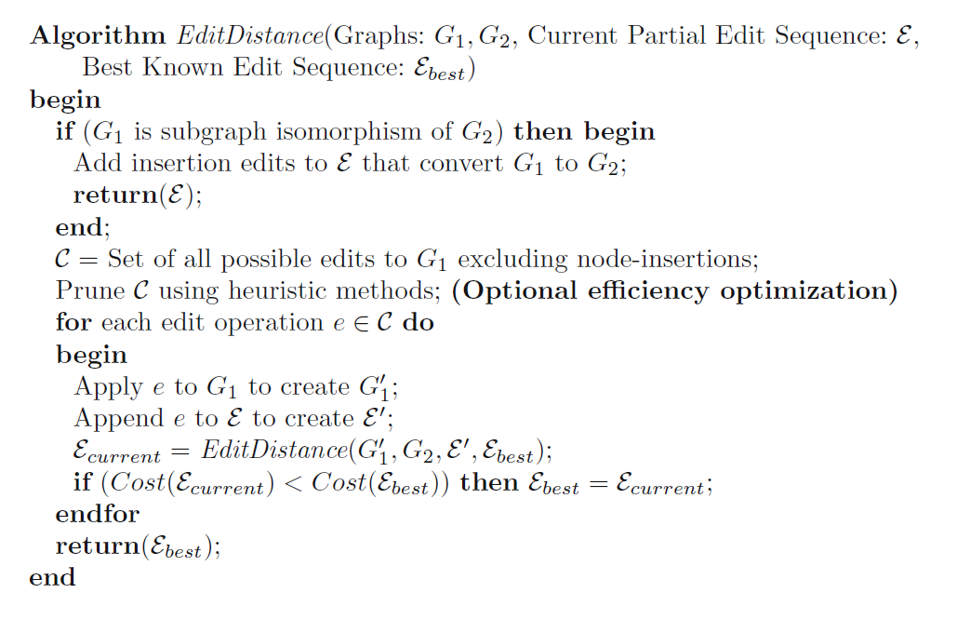
Graph edit distance
Minimum cost of operations needed to transform one graph into another
We have costs of:
Deleting, inserting and changing labels of nodes
Deleting and inserting edges (possibly changing weights too)
We can establish some order of operations that does not change the generality

Slide 8
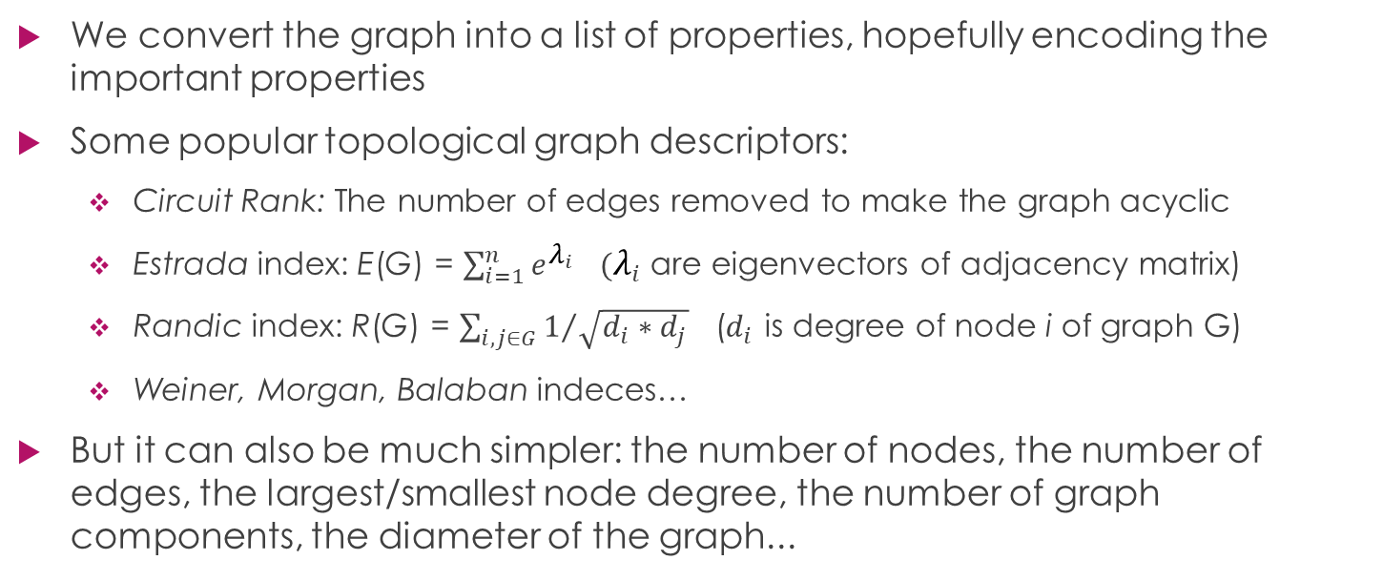
Topological graph descriptors
We convert the graph into a list of properties, hopefully encoding the important properties
Some popular topological graph descriptors:
Circuit Rank: The number of edges removed to make the graph acyclic
Estrada index: E(G) = $\sum_{i=1}^{n}{e^{λ_{i}}}$ $(λ_{i}$ are eigenvectors of adjacency matrix)
Randic index: R(G) = $\sum_{i, j∈G}{1/{\sqrt{d_{i}∗d_{j}}}}$ ($d_{i}$ is degree of node i of graph G)
Weiner, Morgan, Balaban indeces…
But it can also be much simpler: the number of nodes, the number of edges, the largest/smallest node degree, the number of graph components, the diameter of the graph...

Slide 9
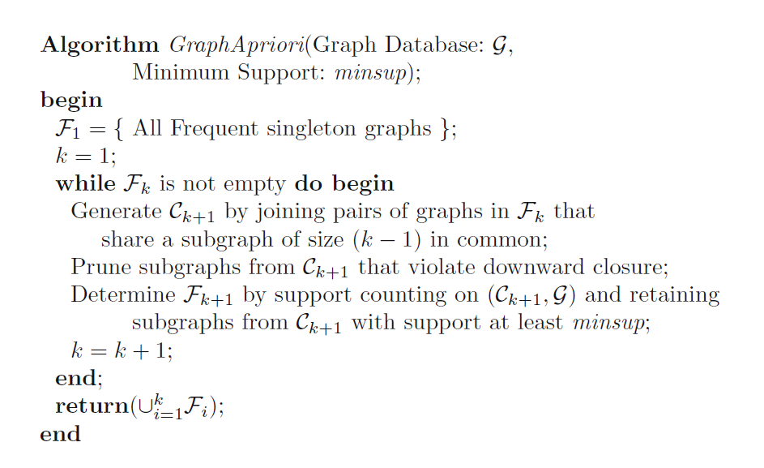
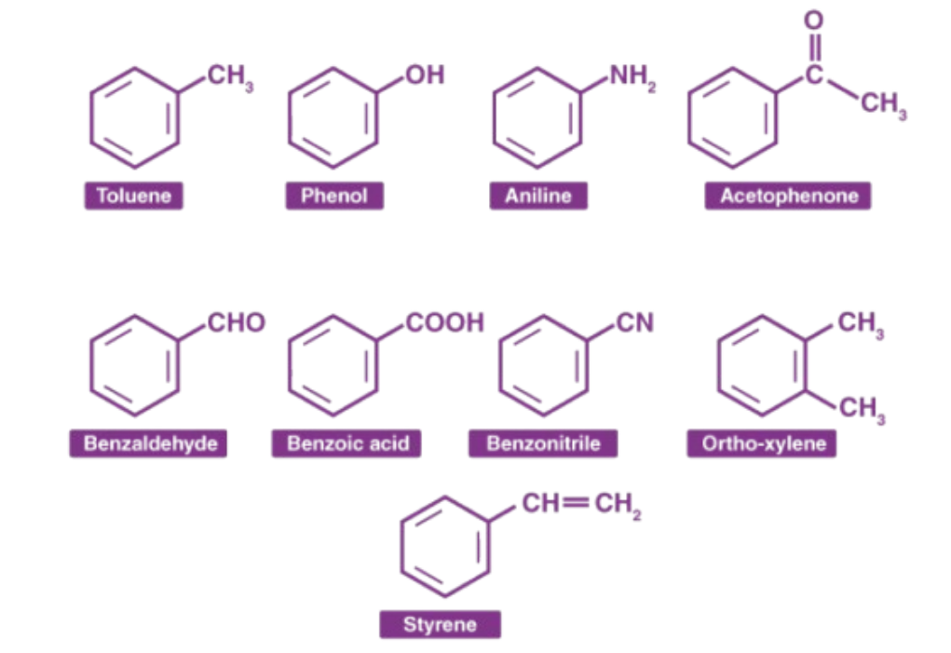
Frequent subgraph mining
We’re using Apriori algorithm

Slide 10
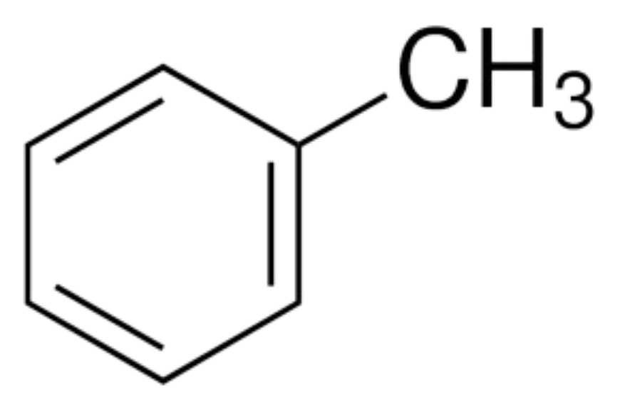
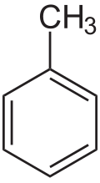
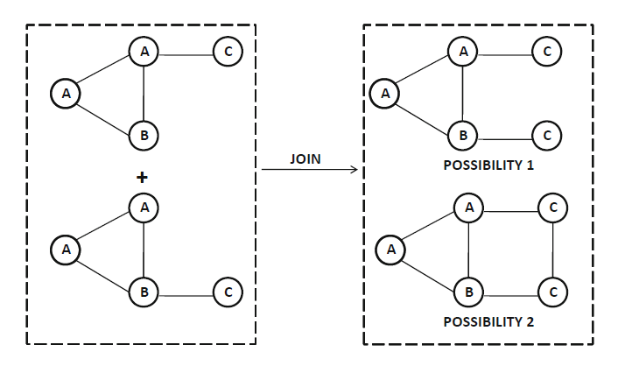
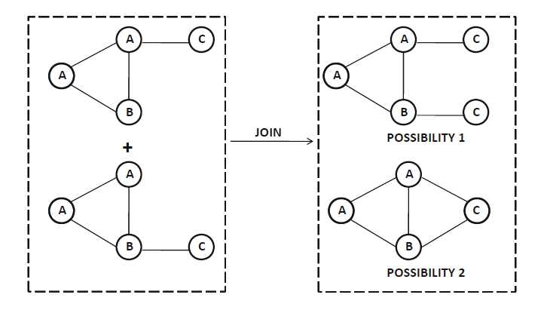
Frequent subgraph mining
Whether to define the size of the graph via the number of nodes or edges -> two approaches to generating frequent subgraphs
Symmetries are the enemy of the Apriori algorithm (toluene example)
Using nodes
Using edges

Slide 11
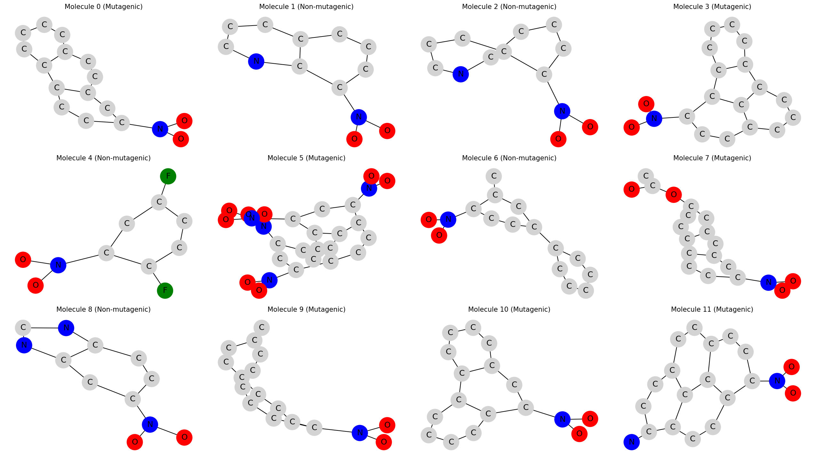
Results
Dataset used: MUTAG - the aim is to predict the mutagenicity of nitroaromatic compounds

Slide 12
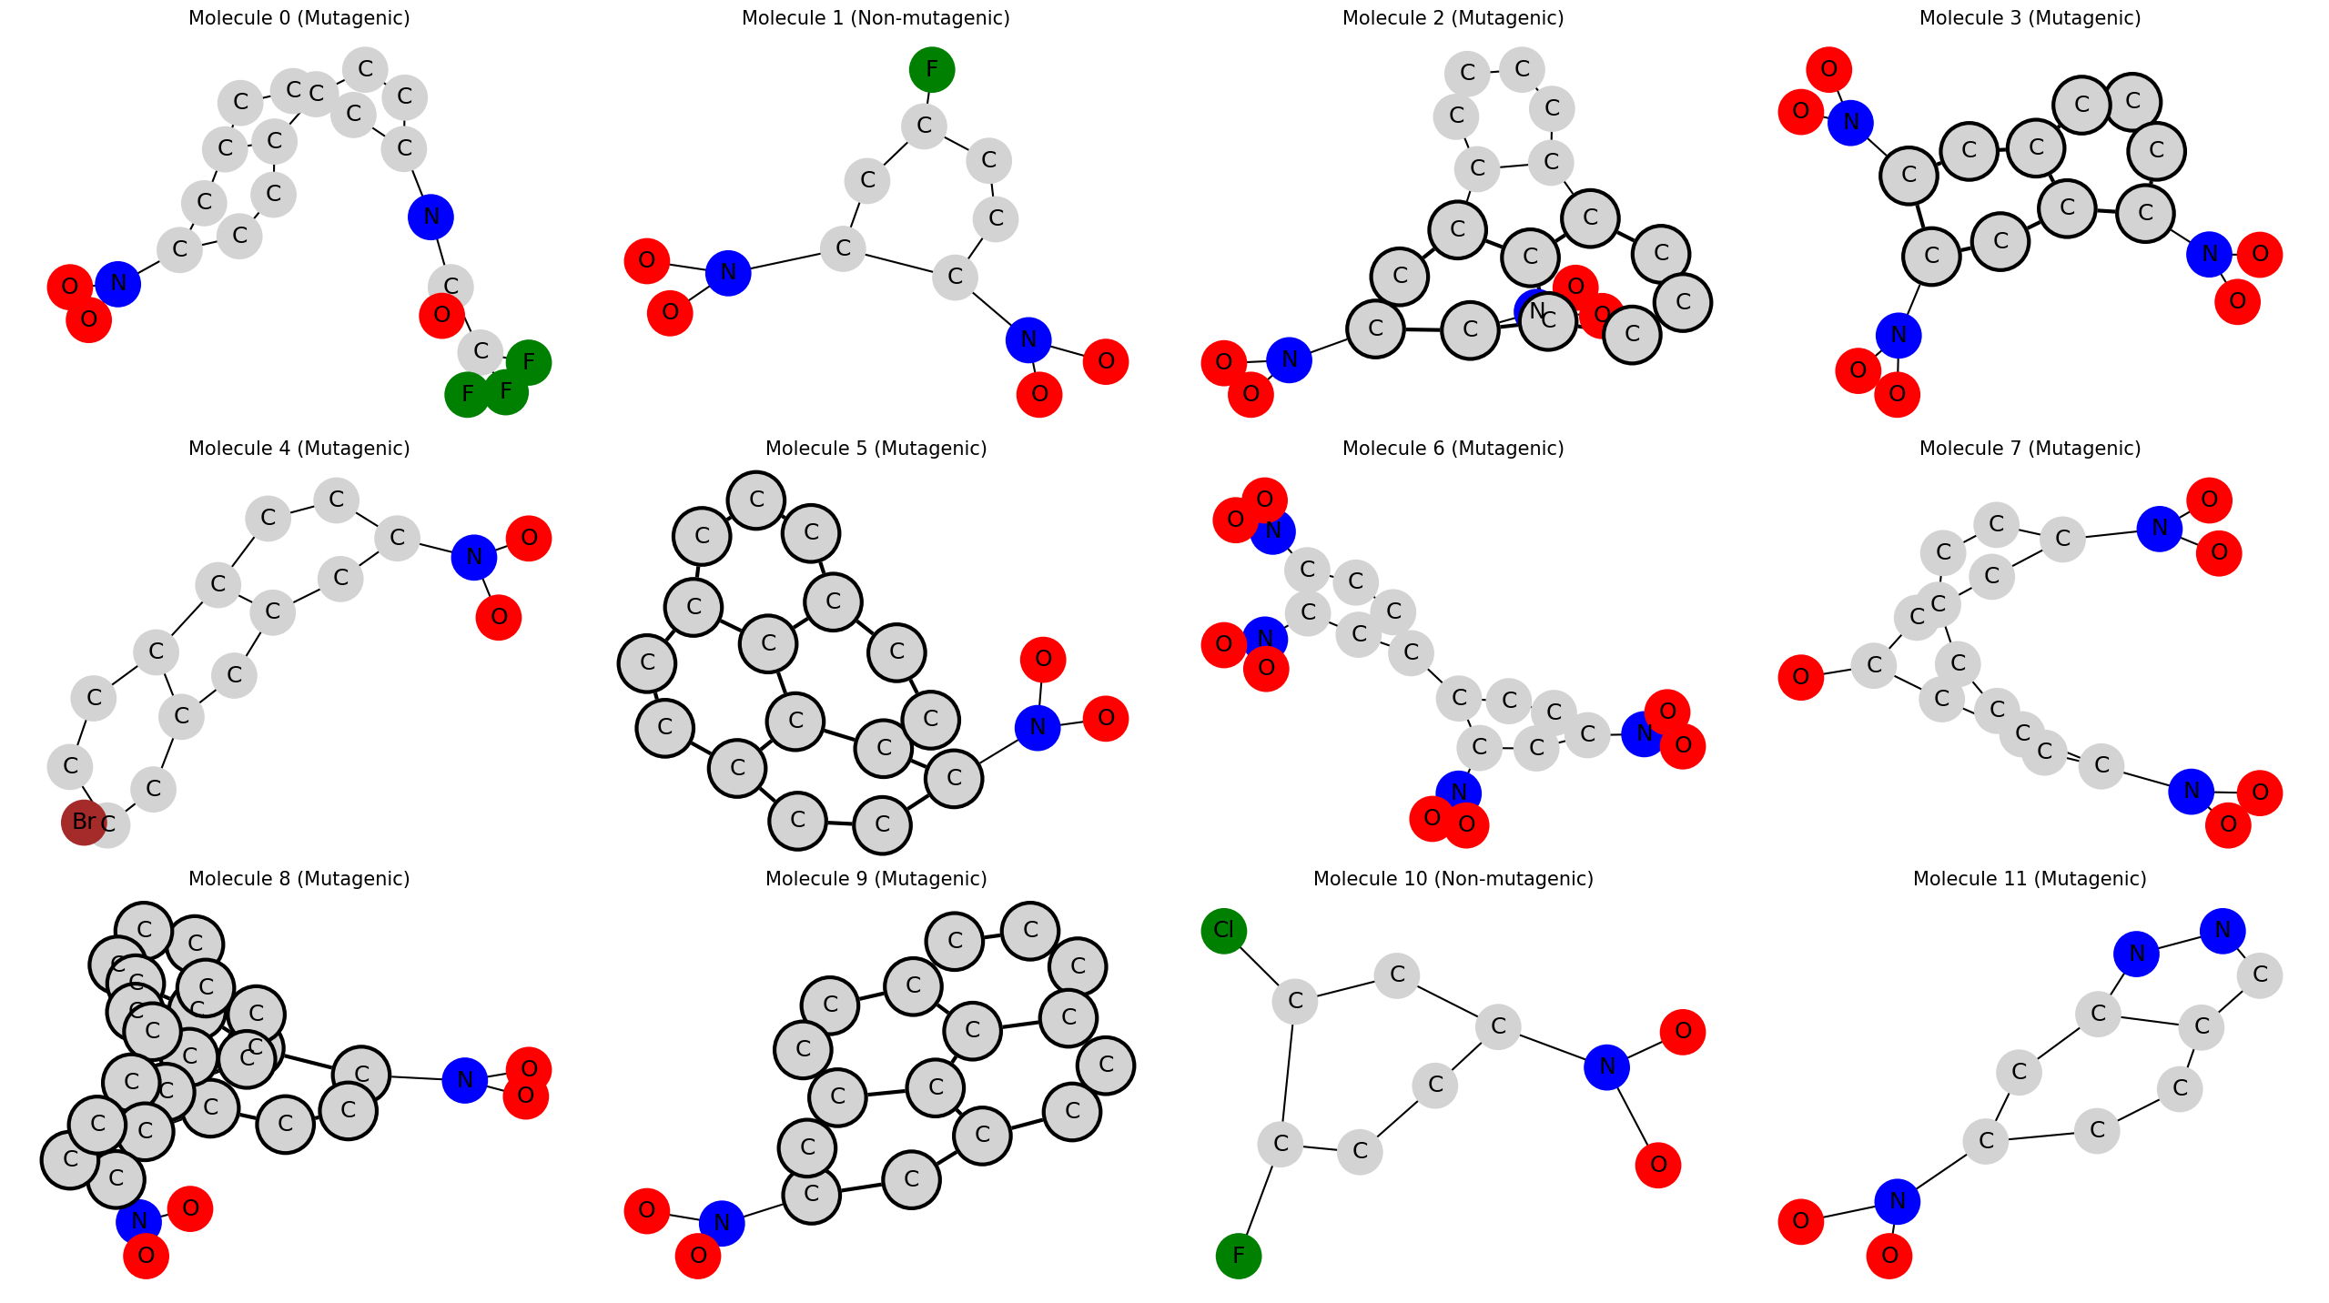
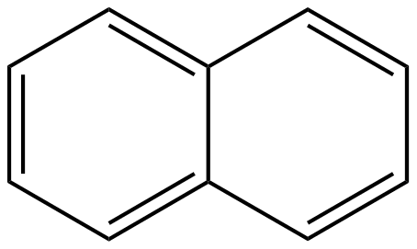
Results
Ullmann's algorithm for subgraph isomorphism
All matches with naphthalene (double hexagon) were searched

Slide 13
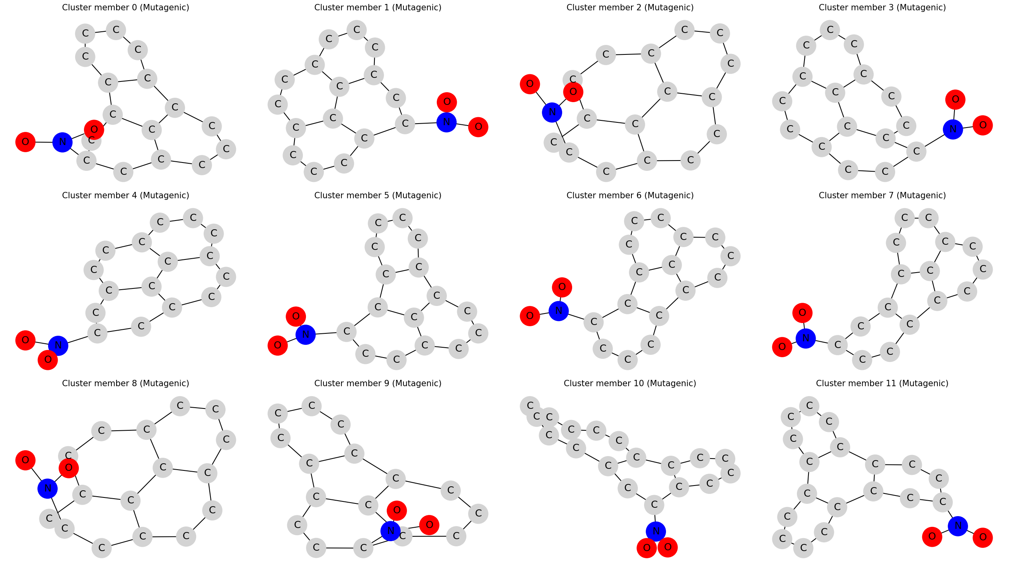
Results
Clustering via topological descriptors
The used algorithm (OPTICS) did not have any information about element labels!
Classification:
SVM: 87%
GaussianNB: 88%
Logistička regresija: 85%

Slide 14
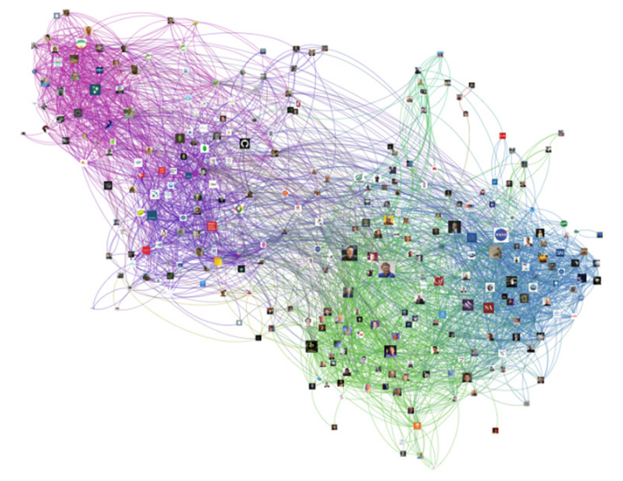
Problems
Scalability
NP hard calculations
We look for meaningful traits ourselves
The larger and more heterogeneous the graph, the richer the representation required
Solution: Graph Neural Networks

Slide 15
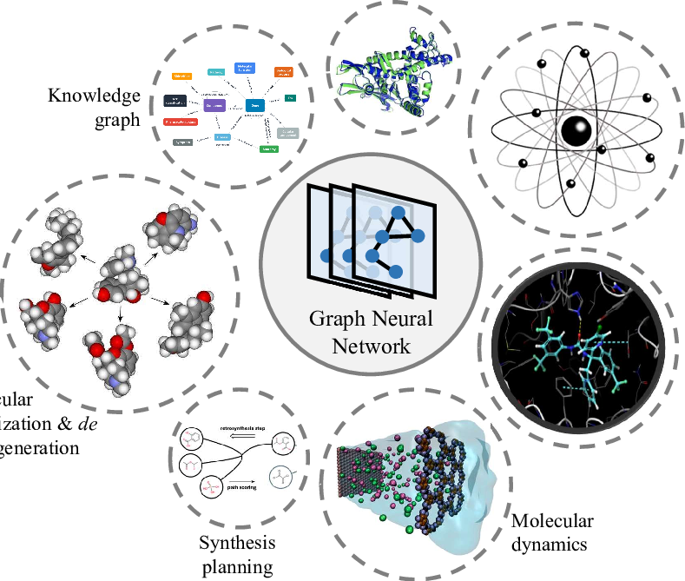
Graph Neural Networks(GNNs)
Marko Cvijetinović 7/2022

Slide 16
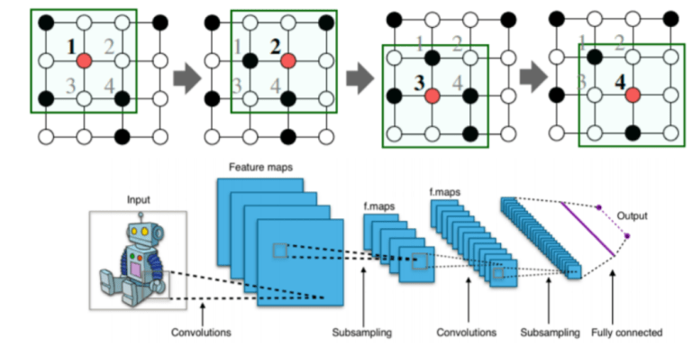
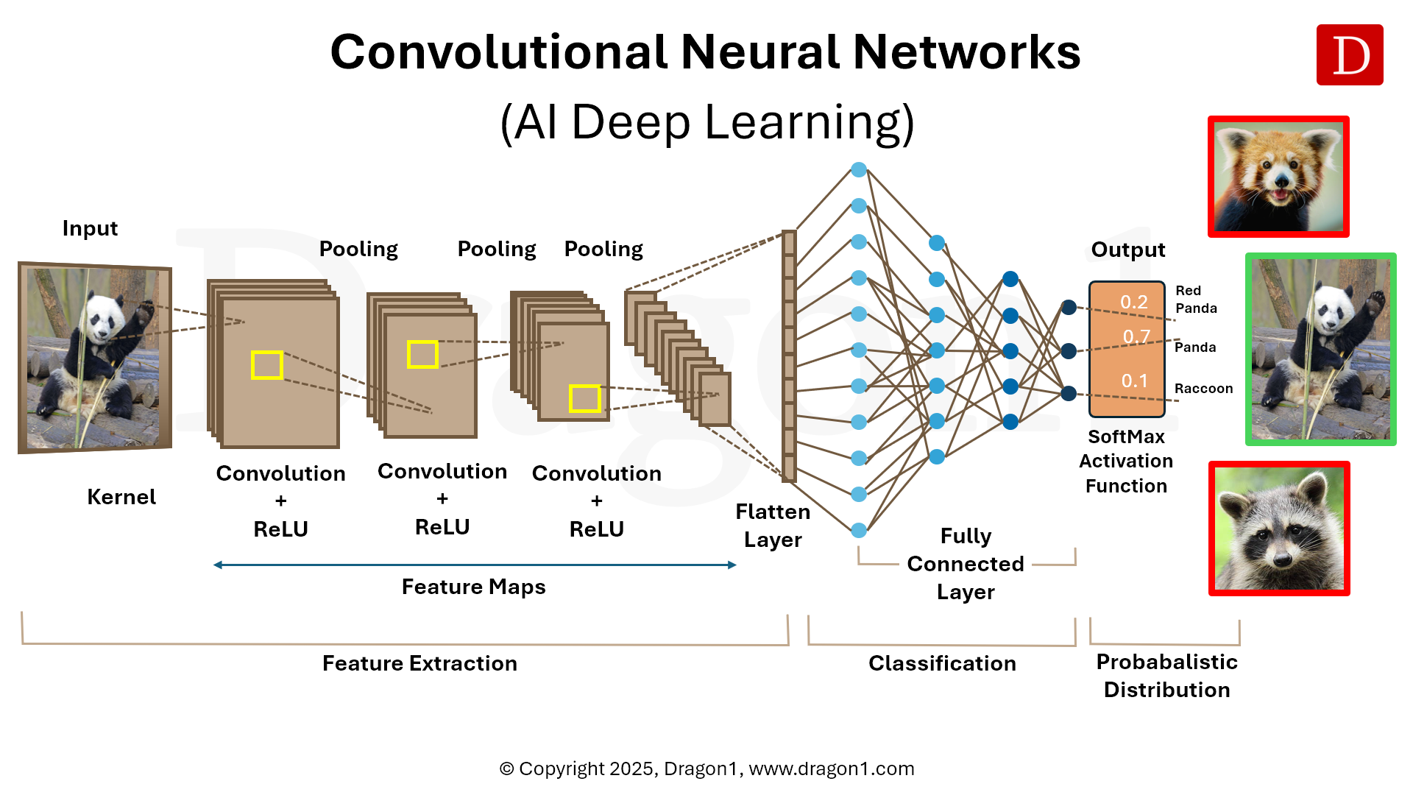
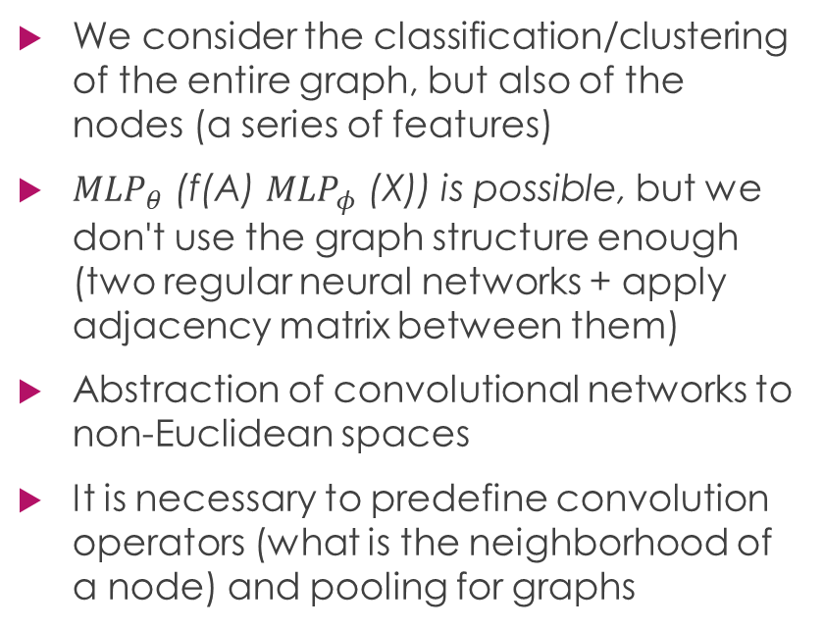
Graph Convolutional Networks (GCNs)
We consider the classification/clustering of the entire graph, but also of the nodes (a series of features)
${MLP}_{θ}$ (f(A) ${MLP}_{φ}$ (X)) is possible, but we don't use the graph structure enough (two regular neural networks + apply adjacency matrix between them)
Abstraction of convolutional networks to non-Euclidean spaces
It is necessary to predefine convolution operators (what is the neighborhood of a node) and pooling for graphs

Slide 17
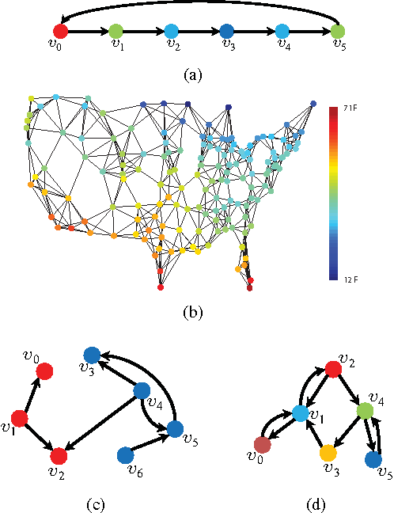
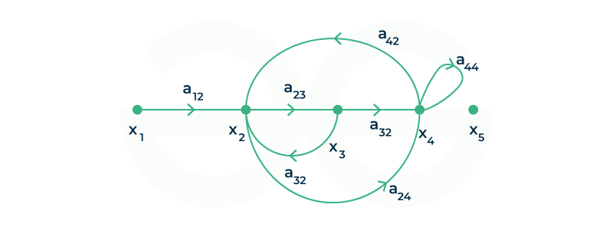
Graph Convolutional Networks (GCNs)
Transition from a spatial signal (image) to a graph one
Each iteration transmits a signal from a node to its neighbors
The adjacency matrix mathematically describes this because its multiplication with the vector of some nodes outputs their neighbors

Slide 18
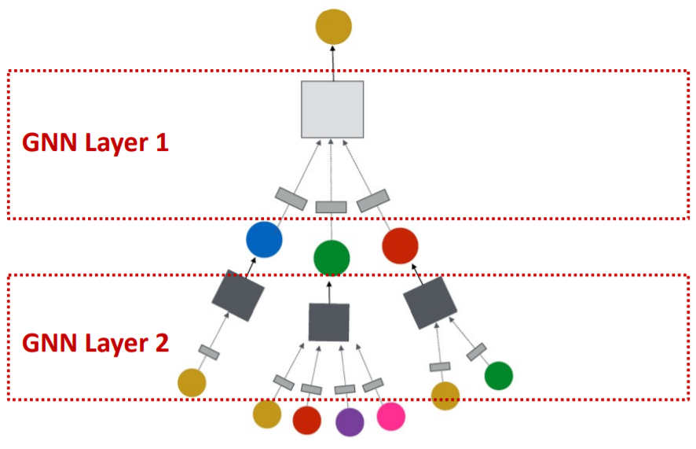
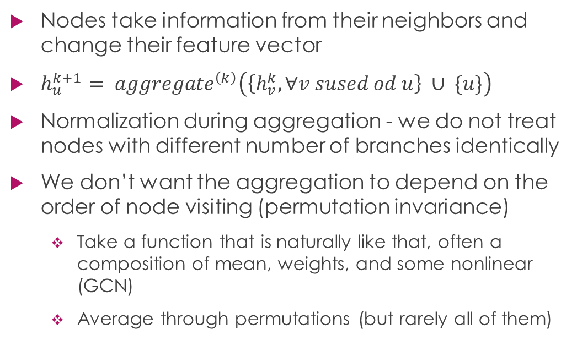
Aggregate
Nodes take information from their neighbors and change their feature vector
$h_{u}^{k+1}= {aggregate}^{\left(k\right)}\left(\left\{h_{v}^{k}, ∀v sused od u\right\} ∪ \{u\}\right)$
Normalization during aggregation - we do not treat nodes with different number of branches identically
We don’t want the aggregation to depend on the order of node visiting (permutation invariance)
Take a function that is naturally like that, often a composition of mean, weights, and some nonlinear (GCN)
Average through permutations (but rarely all of them)

Slide 19
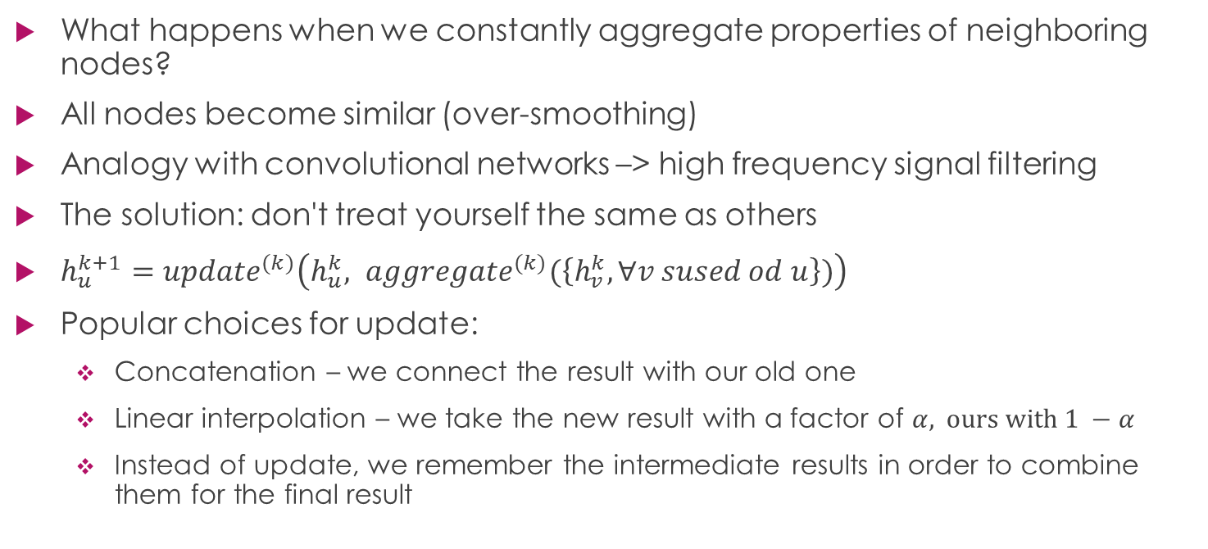
Update
What happens when we constantly aggregate properties of neighboring nodes?
All nodes become similar (over-smoothing)
Analogy with convolutional networks –> high frequency signal filtering
The solution: don't treat yourself the same as others
$h_{u}^{k+1}={update}^{(k)}\left(h_{u}^{k}, {aggregate}^{(k)}(\left\{h_{v}^{k}, ∀v sused od u\right\})\right)$
Popular choices for update:
Concatenation – we connect the result with our old one
Linear interpolation – we take the new result with a factor of $α, ours with 1 −α$
Instead of update, we remember the intermediate results in order to combine them for the final result

Slide 20
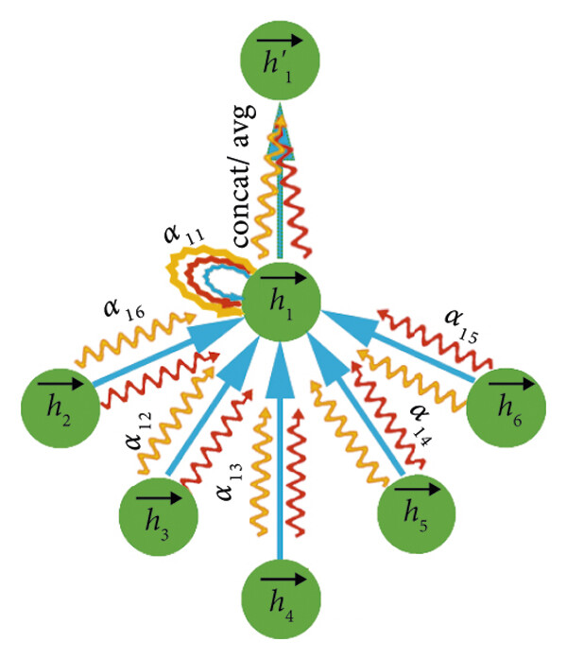
Graph Attention Networks (GATs)
Should all relationships be treated equally? Sometimes not
Each branch is assigned a learning weight (attention)
A more expressive model
Some k weights for branches (attention heads) can be calculated in different ways, then aggregate the result

Slide 21
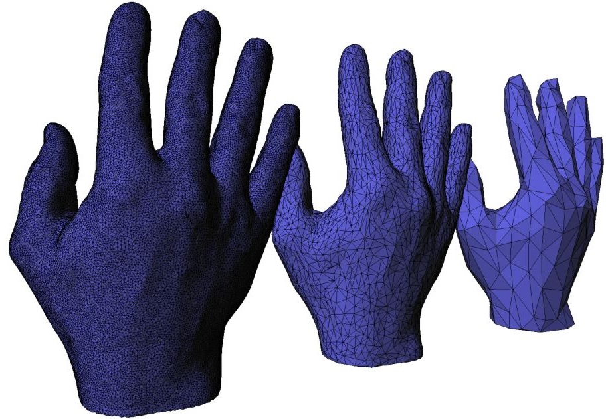
Pooling
Whole graph classification and clustering
Most simply, we calculate the value for the graph via the sum or mean of the node values
We can be inspired by convolutional networks
Each iteration reduces graph complexity (graph coarsening)
Clustering nodes into smaller graphs that become new nodes
Or dropping least important nodes
Hopefully we retain relevant properties of the graph

Slide 22
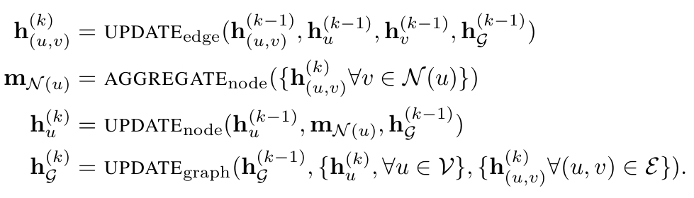
Modifications
The number of parameters can be reduced if the layers of the neural network share weights, thereby reducing overfitting
We can randomly throw out some edges during learning, hopefully this will prevent the algorithm from "learning by rote“
What is properties of the graph at the level of edges or the entire graph are significant?
We can add them to the message passing and learning process

Slide 23
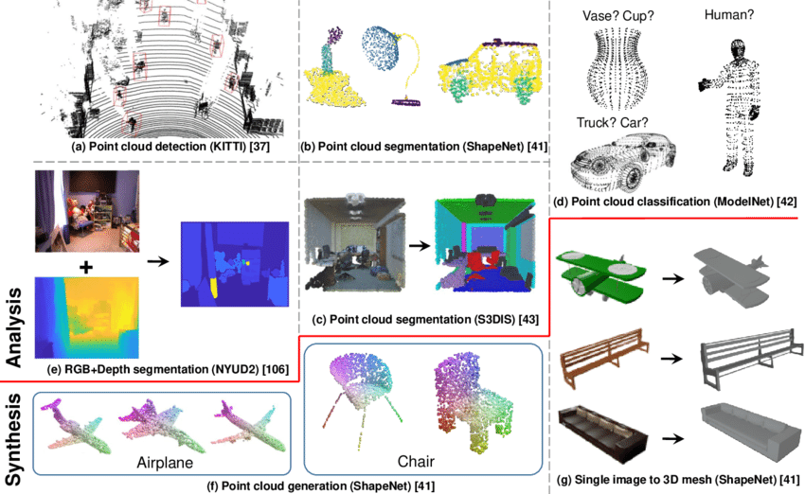
Applications
Geometric learning
Prediction of chemical properties, especially in drugs
Recommendation systems
Bot detection
Prediction of traffic jams

Slide 24
Thank you for your attention!
Github with codes: https://github.com/MarkoCvijetinovic/graph-mining-mutag
Literature: Data Mining: The Textbook, Charu C. Aggarwal
Graph Representation Learning, William L. Hamilton

